Slide 1
Virtual Assistant Development (CAA1C13) Project Report
Chan Jun Qi, Julius
2082753a

Slide 2

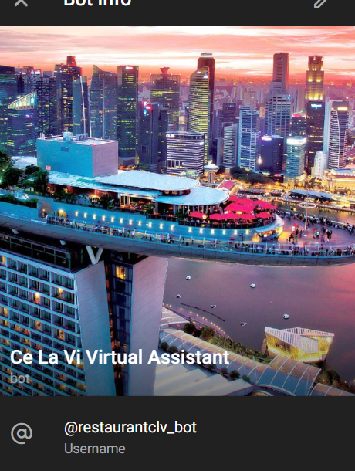
Background
Diner was developed using Ce La Vi restaurant as a project sample. The chatbot helps to easily make a reservation while giving all the information you need about the restaurant.
The chatbot is prepared to respond to the inquiries and give more information to help customers to make the most of their visit. It attempts to address general topics like "menu“, "hours of operation," or "the atmosphere of restaurant”.
Telegram @restaurantclv_bot

Slide 3
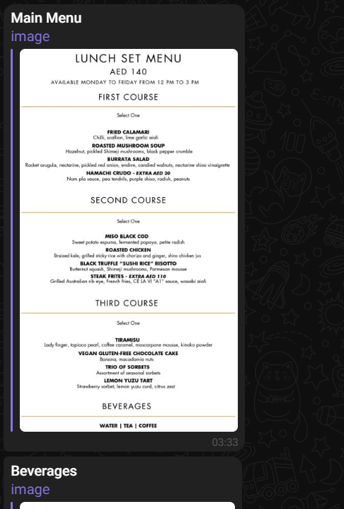
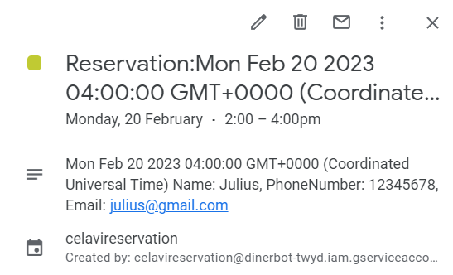
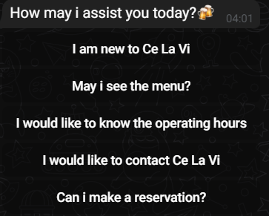
Features
The restaurant chatbot is available 24/7 as its integrated with the telegram channel , reservations can be made which saves the reservation date to google calendar and inform customers if there is another booking on the selected date.
The chatbot is always up-to-date with the latest menu items and specials, ensuring that you have access to the most current information.
The productivity of the restaurant employees will rise as a result of the virtual assistant, which is another perk. The chatbot handle answering frequently asked questions instead of requiring assistance from each of the restaurant employees.

Slide 4
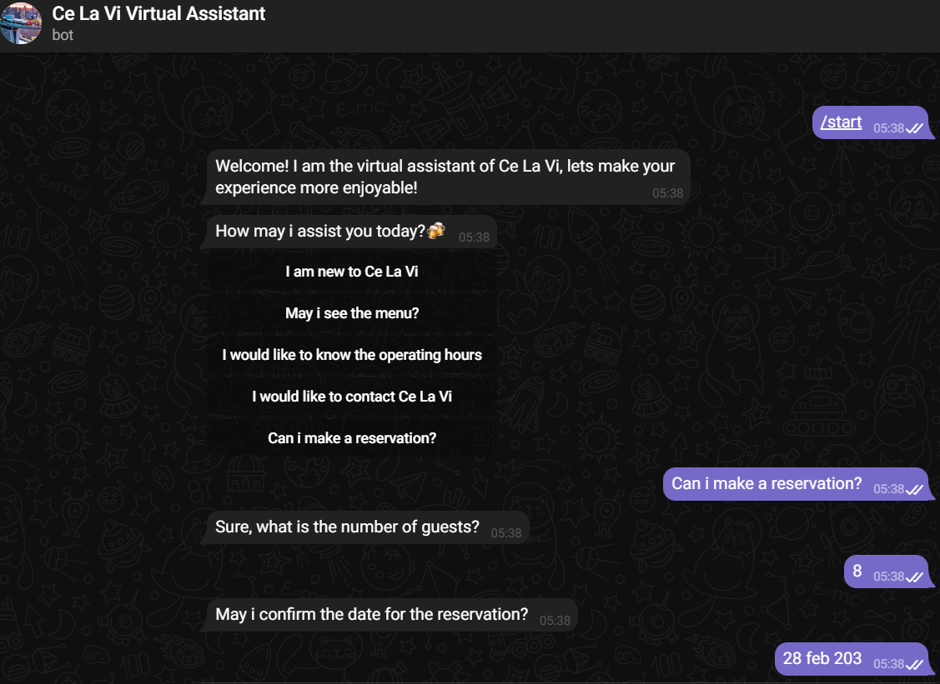
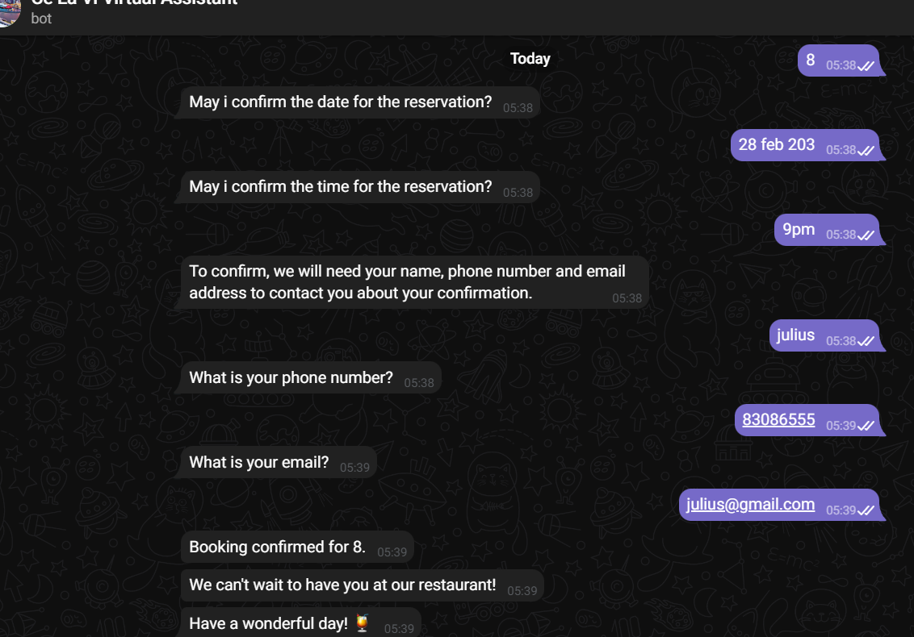
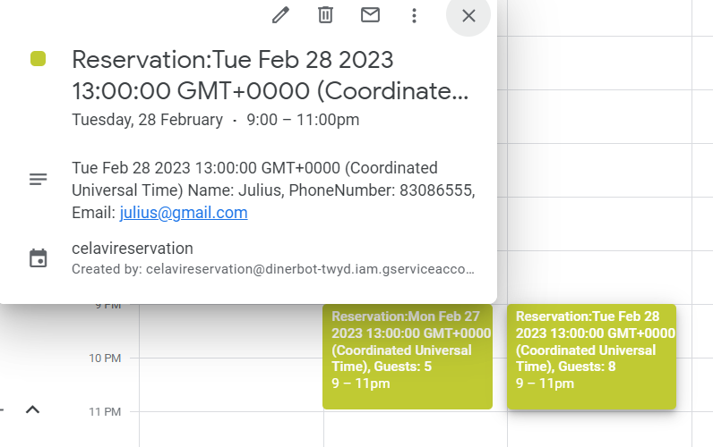
Scenario (Reservation)

Slide 5
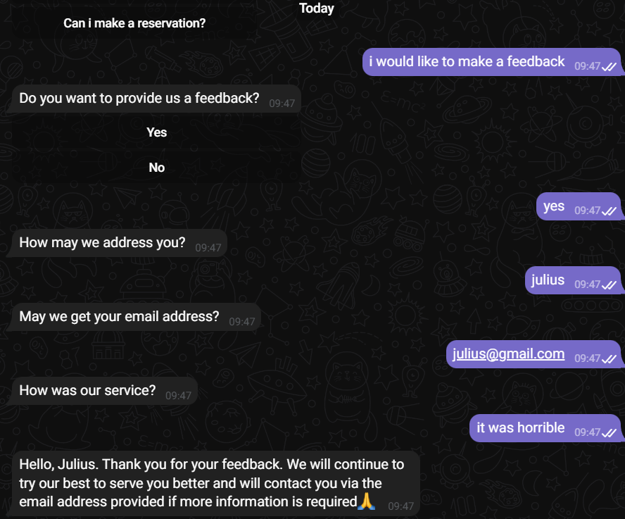
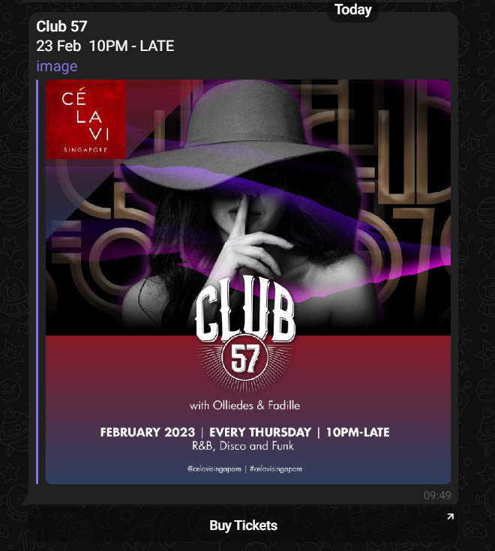
Scenario (Feedback, Facilities & Events)

Slide 6
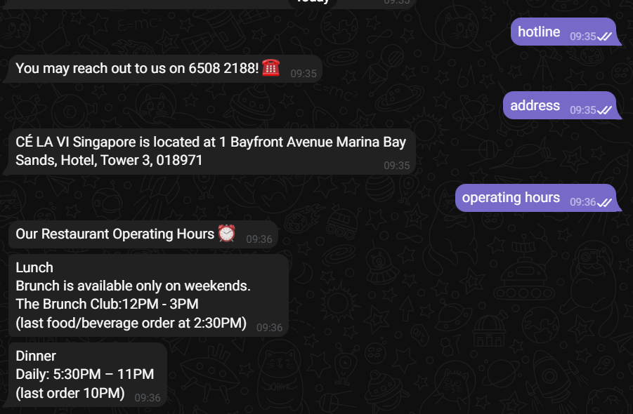
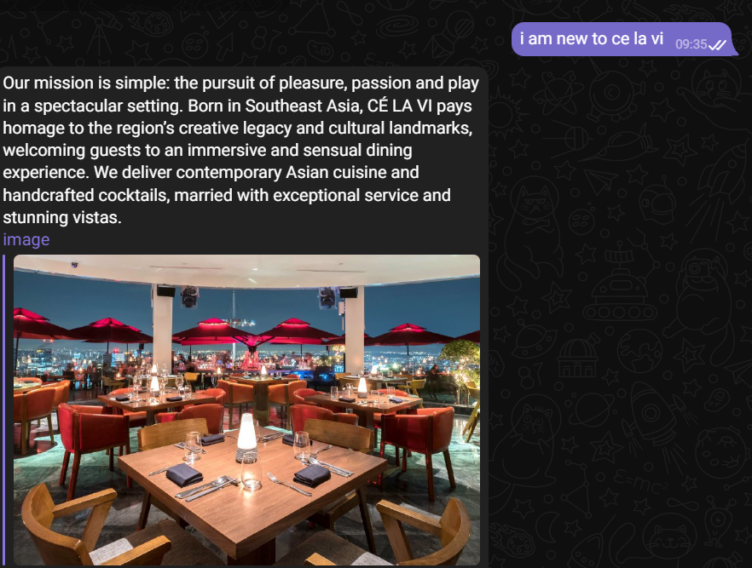
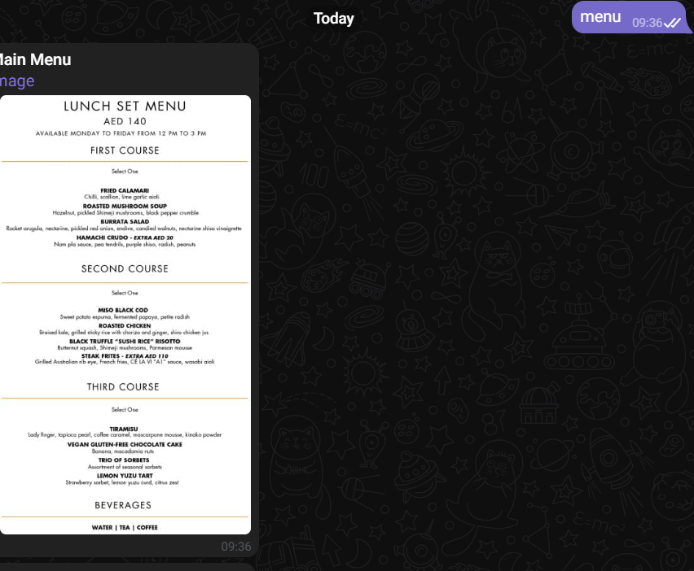
Scenario (General Questions)

Slide 7
Assumptions
When customers reserve a date, the reservation intent will be validated with the restaurant's Google calendar to check for availability, informing them of the date's availability. Another validation step is to make sure the consumer has entered all the necessary data, such as a valid email address and an 8-digit phone number.
The restaurant's feedback intent is more of a sentiment analysis. Using the message entity, it will divide the input into either positive or negative comments. To keep customers, the restaurant will filter and highlight the bad reviews and implement service recovery.

Slide 8
Proposed Functions
The "Order Taking" intent where you can take orders and track status was initially supposed to be used for this Project, however it may not be appropriate given that the restaurant that is created is based on a fine-dining establishment and not a fast-food restaurant.
Initially, using Google Maps API for the project was also planned, however this information can be easily found online using the direct text response on the virtual assistant.

Slide 9
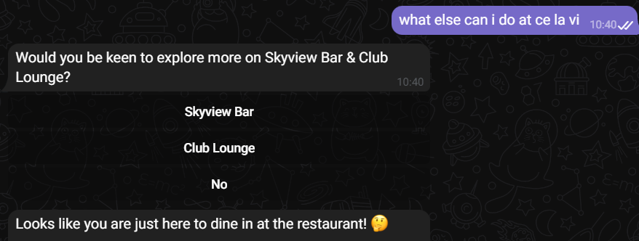
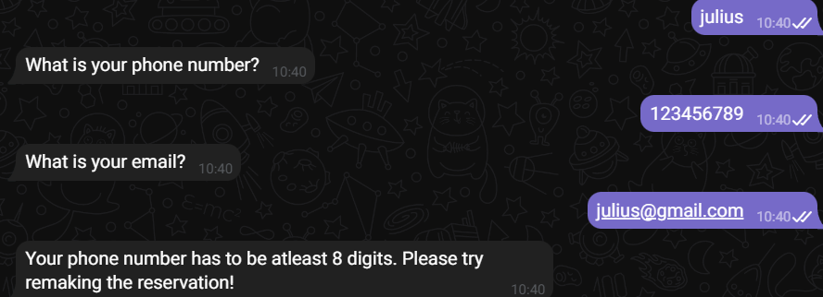
Improvements
One of the features improved was adding validation for the reservation intent integrated with the Google Calendar API. The validation ensures that customers input all necessary and accurate information; otherwise, reservations cannot be made.
Including recommendation chips and responses for specific topics also enables customers to understand what is available at the restaurant without having to physically type it in.
A positive user experience may also be achieved by reducing the number of follow-ups in the process flow to 1 or 2, since this eliminates the need for the customers to keep typing.

Slide 10
Conclusion
Creating a large library of replies that can properly and effectively respond to client enquiries is one of the challenges but researching what are the FAQs that customers asked gave an idea. It is also crucial to make sure that the chatbot is both engaging and user-friendly. It should also be periodically review and updated especially when it comes to menu items & events so a lookout on the website information is needed.
Another difficulty was the chatbot's backend, which required careful attention to all parameters, including timezone and date, in order to guarantee real-time availability and immediately update the system as bookings were made.

